Slide 1
Cyber Security
Keeping data safe is extremely important for many reasons. It may be personal
data that you want to keep within your family or close friends, or it may be
commercial data, such as passwords and bank details.
Cyber threats
» brute force attacks
» data interception
» distributed denial of service (DDoS) attacks
» hacking
» malware (viruses, worms, Trojan horse, spyware, adware and ransomware)
» phishing
» pharming
» social engineering.

Slide 2
https://www.youtube.com/watch?v=6BJLmfscrqo

Slide 3
Brute force attacks
If a hacker wants to ‘crack’ your password, they can systematically try all the
different combinations of letters, numbers and other symbols until eventually
they find your password. This is known as a brute force attack and there isn’t a
lot of sophistication in the technique.
Reference for kids - https://www.youtube.com/watch?v=fHsJAei2ocM

Slide 4
Data interception
Data interception is a form of stealing data by tapping into a wired or wireless communication link. The intent is to compromise privacy or to obtain confidential information. Interception can be carried out using a packet sniffer, which examines data packets being sent over a network. The intercepted data is sent back
Reference : https://www.youtube.com/watch?v=74gfIQEx6rw

Slide 5
Distributed Denial of Service (DDoS) attacks
A denial of service (DoS) attack is an attempt at preventing users from accessing part of a network, notably an internet server. This is usually temporary but may be a very damaging act or a large breach of security. It doesn’t just affect networks; an individual can also be a target for such an attack. The attacker may be able to prevent a user from:
» accessing their emails
» accessing websites/web pages
» accessing online services (such as banking).
Reference : https://www.youtube.com/watch?v=ilhGh9CEIwM

Slide 6
SPAM
Spam is digital junk mail — unsolicited communications sent in bulk over the internet or through any electronic messaging system.
spamming is the act of sending these messages, and a person who engages in the practice is a spammer. Most of the time, spamming is commercial in nature, and though the spam is bothersome, it isn’t necessarily malicious or fraudulent (though it can be).

Slide 7
Origin - https://www.youtube.com/watch?v=_bW4vEo1F4E
Why is it called spam?
The use of the term “spam” to describe this type of invasive blanket-messaging is a reference to a Monty Python skit. In it, a group of diners (clad in Viking costumes, no less) loudly and repeatedly proclaim that everyone must eat Spam, regardless of whether they want it or not. It’s similar to how an email spammer will flood your inbox with their unwanted messages.
When spelled with a capital S, “Spam” refers to the canned pork product that the above-mentioned Vikings love. Use a lowercase S to discuss the endless flood of emails and other messages that you never asked for.

Slide 8
Hacking
Hacking is generally the act of gaining illegal access to a computer system without the user’s permission. This can lead to identity theft or the gaining of personal information; data can be deleted, passed on, changed or corrupted.
Hacking can be prevented through the use of firewalls, user names and frequently changed strong passwords. Anti-hacking software and intrusion-detection software also exists in the fight against hacking.

Slide 9
Hackers
https://www.youtube.com/watch?v=rPlxvo3c_Zk
INternet Safety for kids: Hacking explained :
https://www.youtube.com/watch?v=RbbhDA5_EzI

Slide 10
Malware
Malware is one of the biggest risks to the integrity and security of data on a computer system. There are many forms of malware; this chapter will only consider the following in any detail:
Viruses
Worms
Trojan horse
Spyware
Ransomware

Slide 11
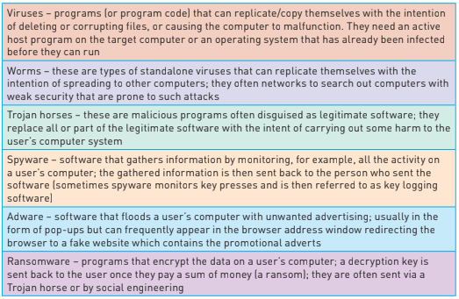

Slide 12
Malware Videos for reference
https://www.youtube.com/watch?v=n8mbzU0X2nQ
https://www.youtube.com/watch?v=AfZxUK9U3hE

Slide 13
Phishing
Phishing occurs when a cybercriminal sends out legitimate-looking emails to users. The emails may contain links or attachments that, when initiated, take the user to a fake website; or they may trick the user into responding with personal data (for example, bank account details or credit/debit card details).
The email usually appears to be genuine coming from a known bank or service provider (also refer to Section 5.3.2). The key point is that the recipient has to initiate some act before the phishing scam can cause any harm. If suspicious emails are deleted or not opened, then phishing attacks won’t cause any problems.

Slide 14
Activity
Reference Video:
https://www.youtube.com/watch?v=R12_y2BhKbE
What are the ways to prevent phishing attacks ?
What is spear Phishing?

Slide 15
Pharming
Pharming is malicious code installed on a user’s computer or on an infected website. The code redirects the user’s browser to a fake website without the user’s knowledge. Unlike phishing, the user doesn’t actually need to take any action for it to be initiated. The creator of the malicious code can gain personal data, such as bank details, from the user. Often the website appears to come from a trusted source and can lead to fraud and identity theft.

Slide 16
DNS Cache Poisoning
Every time a user types in a URL, their browser contacts the DNS server; the IP address of the website will then be sent back to their browser. However, DNS cache poisoning changes the real IP address values to those of the fake website; consequently, the user’s computer will connect to the fake website.
Activity:
Study the steps to mitigate against the risk of pharming:

